Slide 1
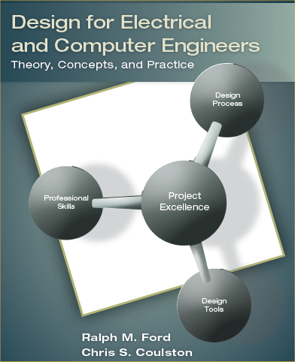
The Requirements Specification Chapter 3

Slide 2
Learning Objectives
By the end of this section, you should:
Understand the properties of an engineering requirement and know how to develop well-formed requirements that meet the properties.
Be familiar with engineering requirements that are commonly specified in electrical and computer systems.
Understand the properties of the complete requirements specification, as well as knowing the steps to develop one.
Be able to conduct advanced requirements analysis to identify tradeoffs.

Slide 3
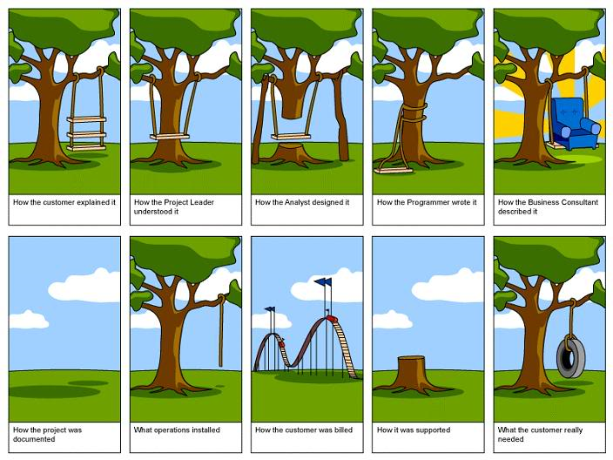

Slide 4
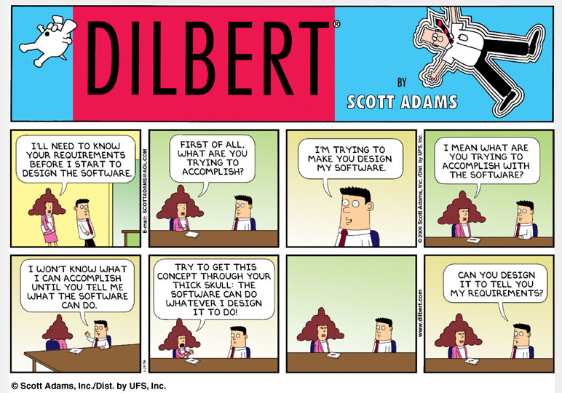

Slide 5
So What can we do?
So we need a process to better understand what is needed ….
We need to make sure our design will meet the goals of the customer.
Requirements Specifications Process

Slide 6
Definitions
Marketing Requirement – statements of the customer’s needs.
Engineering Requirement – short statements that address a technical need of the design.
Requirements Specification – collection of marketing and engineering requirements that a system must satisfy in order for it to satisfy the needs of a customer or end user.

Slide 7
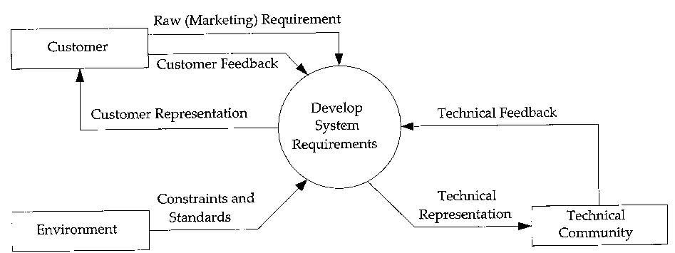
Overview of Requirements Specifications Process
Collection of
Marketing Requirements
Engineering Requirements
Stakeholders
Customers
Environment
Technical community
IEEE Guide for Developing System Requirements Specifications: IEEE std. 1233-1998

Slide 8
Engineering Requirements
Short statements stating the technical needs
System should be able to supply 30 W power.
Initiated by the marketing requirements to satisfy customer needs

Slide 9
Types of Requirements: Functional and Non-Functional
Functional requirements describe system services or functions
Compute sales tax on a purchase
Update the database on the server ...
Non-functional requirements are constraints on the system or the development process
Non-functional requirements may be more critical than functional requirements.
If these are not met, the system might turn out to be not of much use!

Slide 10
Types of Non-Functional Requirements
© Ian Sommerville 2000
Notes:
ch5

Slide 11
Non-Functional Requirements: Definitions and Examples
Product requirements | specify that the delivered product must behave in a particular way. e.g. execution speed, reliability, etc. | It shall be possible for all necessary communication between the APSE and the user to be expressed in the standard Ada character set.
Organizational requirements | are a consequence of organizational policies and procedures. e.g. process standards used, implementation requirements, etc. | The system development process and deliverable documents shall conform to the process and deliverables defined in XYZCo-SP-STAN-95.
External requirements | arise from factors which are external to the system and its development process. e.g. interoperability requirements, legislative requirements, etc. | The system shall provide facilities that allow any user to check if personal data is maintained on the system. A procedure must be defined and supported in the software that will allow users to inspect personal data and to correct any errors in that data.

Slide 12
Engineering Requirements - Properties
Abstract
Description of capabilities and conditions; should be numerical.
Explains what it does not how it does it.
Verifiable
There are ways to measure and demonstrate that it meets the needs.
Unambiguous
Short and clear
A one-sentence description of the requirement.
Traceable
It can be traced to the original customer need.
Realistic
Must have benchmark(s) and realizable.
Realistic targets – tolerance (e.g.,+/- to ppm)

Slide 13
Engineering Requirements Verifiability
Requirements must be written so that they can be objectively verified.
Imprecise Engineering Requirement Example:
“The system should be easy to use by experienced controllers and should be organized in such a way that user errors are minimized.”
Terms like “easy to use” and “errors shall be minimized” are useless as specifications.
Verifiable Engineering Requirement Example:
“Experienced controllers should be able to use all the system functions after a total of two hours training. After this training, the average number of errors made by experienced users should not exceed two per day.”

Slide 14
Precise Requirements Measures (I)
Property | Measure
Speed | Processed transactions/second User/Event response time Screen refresh time
Size | K Bytes; Number of RAM chips
Ease of use | Training time Rate of errors made by trained users Number of help frames

Slide 15
Precise Requirements Measures (II)
Property | Measure
Reliability | Mean time to failure (MTTF) Probability of unavailability Rate of failure occurrence
Robustness | Time to restart after failure Percentage of events causing failure Probability of data corruption on failure
Portability | Percentage of target dependent statements Number of target systems

Slide 16
Traceability
To protect against changes you should be able to trace back from every system component to the original requirement that caused its presence.
 | C1 | C2 | … | … | Cm
req1 |  | x
req2 | x
… |  |  |  | x
… |  |  |  |  | x
reqn |  | x | x
A software process should help you keep this virtual table up-to-date
Simple techniques may be quite valuable (naming conventions, ...)

Slide 17
A Fifth Property - Realism
IMPORTANT – Your requirements for your project must also be REALISTIC!
You need to demonstrate that the target you have selected is technically feasible.
How are you going to do this?
Benchmarks may serve as points of reference.
Prototypes may be employed.
A solution may be assumed (although violates the abstractness property)

Slide 18
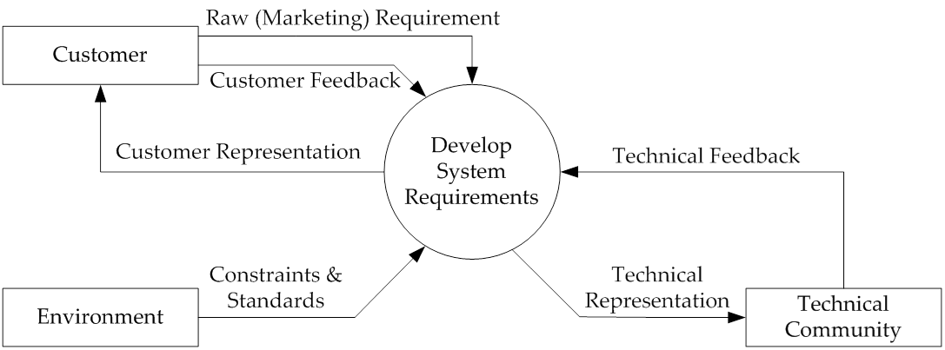
Constraints
Constraint: design decision imposed by the environment or a stakeholder that impacts or limits the design.
Example constraint: The system must use a PIC18F52 microcontroller to implement processing functions.

Slide 19
Standards
Main Question is, what standards are relevant to your project and how do you use them?
Different levels of usage
User
Implementation
Developer
Types: safety, testing, reliability, communication, data, documentation, design, …

Slide 20
Standards
The term "standard," or "technical standard" as cited in the National Technology Transfer and Advancement Act (NTTAA), includes all of the following:
Common and repeated use of rules, conditions, guidelines or characteristics for products or related processes and production methods, and related management systems practices.
The definition of terms; classification of components; delineation of procedures; specification of dimensions, materials, performance, designs, or operations; measurement of quality and quantity in describing materials, processes, products, systems, services, or practices; test methods and sampling procedures; or descriptions of fit and measurements of size or strength.

Slide 21
Types of Standards
Standards may be classified in numerous ways.
Standards can be differentiated based on purpose.
A basic standard has a broad ranging effect in a particular field, such as a standard for metal which affects a range of products from cars down to screws.
Terminology standards (or standardized nomenclature) define words permitting representatives of an industry or parties to a transaction to use a common, clearly understood language.
Test and measurement standards define the methods to be used to assess the performance or other characteristics of a product or process.
Product standards establish qualities or requirements for a product (or related group of products) to assure that it will serve its purpose effectively.
Process standards specify requirements to be met by a process, such as an assembly line operation, in order to function effectively.

Slide 22
Types of Standards – cont’d
Standards may be classified in numerous ways.
Standards can be differentiated based on purpose.
Service standards, such as for repairing a car, establish requirements to be met in order to achieve the designated purpose effectively.
Interface standards, such as the point of connection between a telephone and a computer terminal, are concerned with the compatibility of products.
Standards on data to be provided contain lists of characteristics for which values or other data are to be stated for specifying the product, process or service.
International Standards have been developed through a process that is open to participation by representatives of all interested countries, transparent, consensus-based, and subject to due process.
The existence of non-harmonized standards for similar products, processes, and services in different countries or regions can create barriers to trade.
Therefore, export-minded countries and industries have recognized the need for internationally accepted standards to help rationalize the international trading process.

Slide 23
Types of Standards – cont’d
Standards may also be classified by the intended user group. Some examples include:
Company standards are meant for use by a single industrial organization and usually are developed internally.
International standards are developed and promulgated by international governmental and non-governmental organizations, such as the North Atlantic Treaty Organization (NATO) or the International Organization for Standardization (ISO).
Harmonized standards can be either an attempt by a country to make its standard compatible with an international, regional or other standard or it can be an agreement by two or more nations on the content and application of a standard, the latter of which tends to be mandatory.
Industry standards are developed and promulgated by an industry for materials and products related to that industry.
Government standards are developed and promulgated by Federal, State, and local agencies to address needs or applications peculiar to their missions and functions.

Slide 24
Types of Standards – cont’d
Another distinction among standards is the manner in which they specify requirements.
Performance standards describe how a product is supposed to function.
A performance standard for water pipe might set requirements for the pressure per square inch that a pipe must withstand, along with a test method to determine if a specimen meets the requirement.
Design standards define characteristics or how the product is to be built.
The specification that a pipe be made of a given gage of copper would characterize a design standard.

Slide 25
Identifying Engineering Requirements
Structured workshops and brainstorming
Interviews and surveys
Observation of processes and devices in use
Benchmarking and market analysis
Prototyping and simulation
Research survey

Slide 26
Engineering Requirements - Categories
Legal
Maintenance
Operational
Manufacturability
Political
Reliability and availability
Social and cultural
Performance
Functionality
Economic
Energy
Environmental
Safety
Usability

Slide 27
Engineering Requirement Examples
Performance
The system should detect 90% of all human faces in an image.
The amplifier will have a total harmonic distortion less than 1%.
Reliability & Availability
The system will have a reliability of 95% in five years.
The system will be operational from 4AM to 10PM, 365 days a year.

Slide 28
Engineering Requirement Examples – cont’d
Energy
The system will operate for a minimum of three hours without needing recharge.
Environmental
The system should be able to operate in the temperature range of 0°C to 75°C.
The system must be waterproof and operate while submersed in water.
to be recharged.
Many more examples in the book!

Slide 29
The Requirements Specification

Slide 30
Requirements Specification – Characteristics of Properties
Normalized (orthogonal) set
No overlapping or redundancy between requirements
Analogy in Vector Calculus: projection of one requirement onto another is zero (dot product).
Complete set
Contains all requirements
Consistent
No conflicting requirement
Bounded
Contain minimum acceptable bounds for targets
Modifiable
Requirements must be evolutionary
Benchmarked against the baseline requirements

Slide 31
Validation vs. Verification
Validation answers the question “Am I building the right product?” by checking a work product against higher-level work products or authorities that frame this particular product.
Requirements are validated by stakeholders
Verification answers the question “Am I building the product right?” by checking a work product against some standards and conditions imposed on this type of product and the process of its development.
Requirements are verified by the analysts mainly.

Slide 32
How do you VALIDATE requirements?
Ask the customer if the requirements meet their needs.
Usually done in teams.
For each engineering requirement
Traceable?
Verifiable?
Realistic & technical feasible?
For the complete Requirements Specification
Orthogonal?
Complete?
Consistent?

Slide 33
Case Study: Car Audio Amp
Design a car audio amplifier subject to following marketing requirements:
The system should have excellent sound quality.
The system should have high output power.
The system should be easy to install.
The system should have low cost.

Slide 34
Case Study: Car Audio Amp Engineering Requirements
Market. Req. | Engineering Requirements | Justification
1, 2, 4 | The total harmonic distortion should be <0.1%. | Based upon competitive benchmarking and existing amplifier technology. Class A, B, and AB amplifiers are able to obtain this level of THD.
1–4 | Should be able to sustain an output power that averages ≥ 35 watts with a peak value of ≥ 70 watts. | This power range provides more than adequate sound throughout the automobile compartment. It is a sustainable output power for projected amplifier complexity.
2, 4 | Should have an efficiency (η) >40 %. | Achievable with several different classes of power amplifiers.
3 | Average installation time for the power and audio connections should not exceed 5 minutes. | Past trials using standard audio and power jacks demonstrate that this is a reasonable installation time.
4 | The dimensions should not exceed 6” x 8”x 3”. | Fits under a typical car seat. Prior models and estimates show that all components should fit within this package size.
4 | Production cost should not exceed $100. | This is based upon competitive market analysis and previous system designs.
Marketing Requirements (1)The system should have excellent sound quality. (2). The system should have high output power. (3) The system should be easy to install. (4). The system should have low cost.

Slide 35
Case Study: Ipod™ Hands-Free
Marketing Requirements
Should not minimize or slow down the functional quality of the iPod.
User should be able to search for songs and artists and receive feedback on selection.
System should provide clear understandable speech.
System should be able to understand voice commands from user.
Should be able to fit and operate in an automobile.
Should be easy to use.
Should be portable.

Slide 36
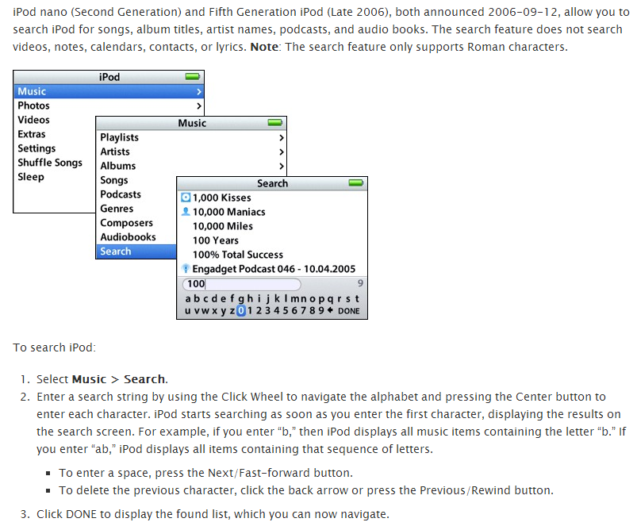
Searching Songs and Artist in Ipod

Slide 37
Case Study: iPod Hands Free
Marketing Requirements | Engineering Requirements | Justification
2, 4, 6 | 1. System will implement ten voice command functions (menu, search, play/pause, previous, next, up, down, left, right and select) and respond appropriately according to each command. | These are the basic commands that are used to control an iPod and will provide all functionality needed for the wireless interface.
1, 2, 3, 4, 7 | 2. The time to respond to voice commands and provide audio feedback should not exceed 3 seconds. | The system needs to provide convenient use by responding to the user inputs within a short time period. Based on research it was determined that the response time for the iPod is less than 1 second and an average voice recognition system requires 2 seconds to recognize commands.
2, 4, 6 | 3. The accuracy of the system in accepting voice commands will be between 95% and 98%. | Research demonstrates that this is a typical accuracy of voice recognition chips. Speaker independent systems can achieve 95% and speaker-dependent up to 98%.
5, 6 | 4. The system should be able to operate from a 12 V source and will draw a maximum of 150 mA. | The automobile provides 12V DC. A current draw budget estimate was developed with potential components and 150mA was an upper limit of current estimated.
5, 6, 7 | 5. The dimensions of the prototype should not exceed 6” x 4” x 1.5”. | This system must be able to fit in a car compartment, somewhere between the seats. Estimate is based upon a size budget calculation using typical parts.
Marketing Requirements Should not minimize or slow down the functional quality of the iPod. User should be able to search for songs and artists and receive feedback on selection. System should provide clear understandable speech. System should be able to understand voice commands from user. Should be able to fit and operate in an automobile. Should be easy to use. Should be portable.

Slide 38
Advanced Requirements Analysis

Slide 39
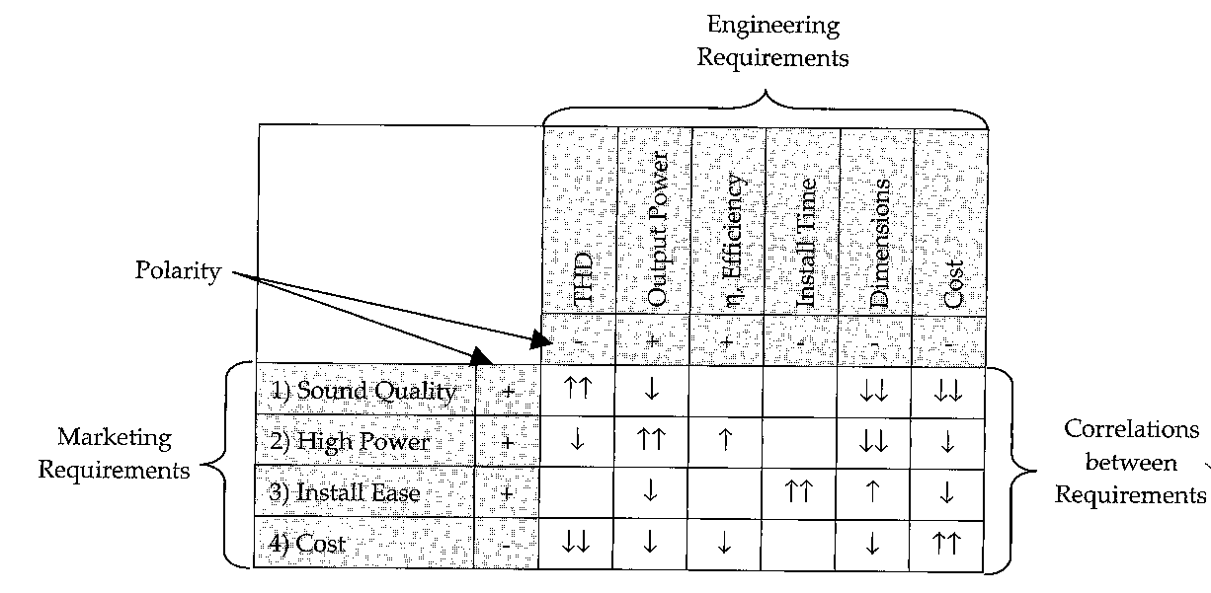
Requirements Analysis Engineering-Marketing Matrix
Understanding the tradeoffs between different conflicting requirements
Identifying engineering and marketing requirements
Requirement correlations
Up Arrow: Positive correlation; Both goals can be simultaneously met
Down Arrow: Negative correlation; Improving one will compromise the other
Polarity
(+) indicates desirability
(-) indicates non-desirability

Slide 40
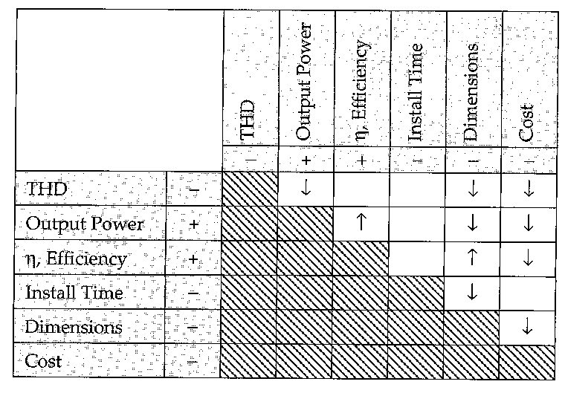
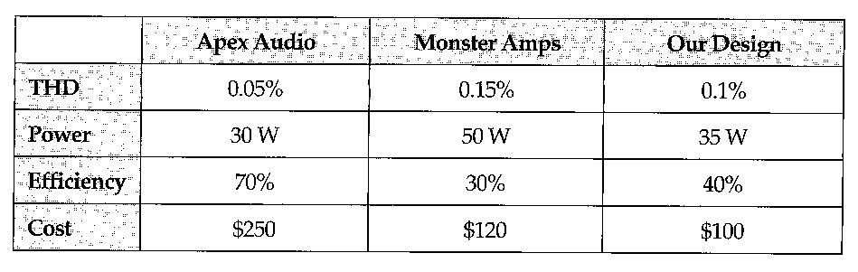
Requirements Analysis Tradeoff Matrix
Engineering Tradeoff Matrix
between different engineering requirements
Remember:
Up Arrow: Positive correlation; Both goals can be simultaneously met
Down Arrow: Negative correlation; Improving one will compromise the other
Competitive Bench Mark
Selecting the target
Understanding realistic gains
Baseline requirement comparison

Slide 41
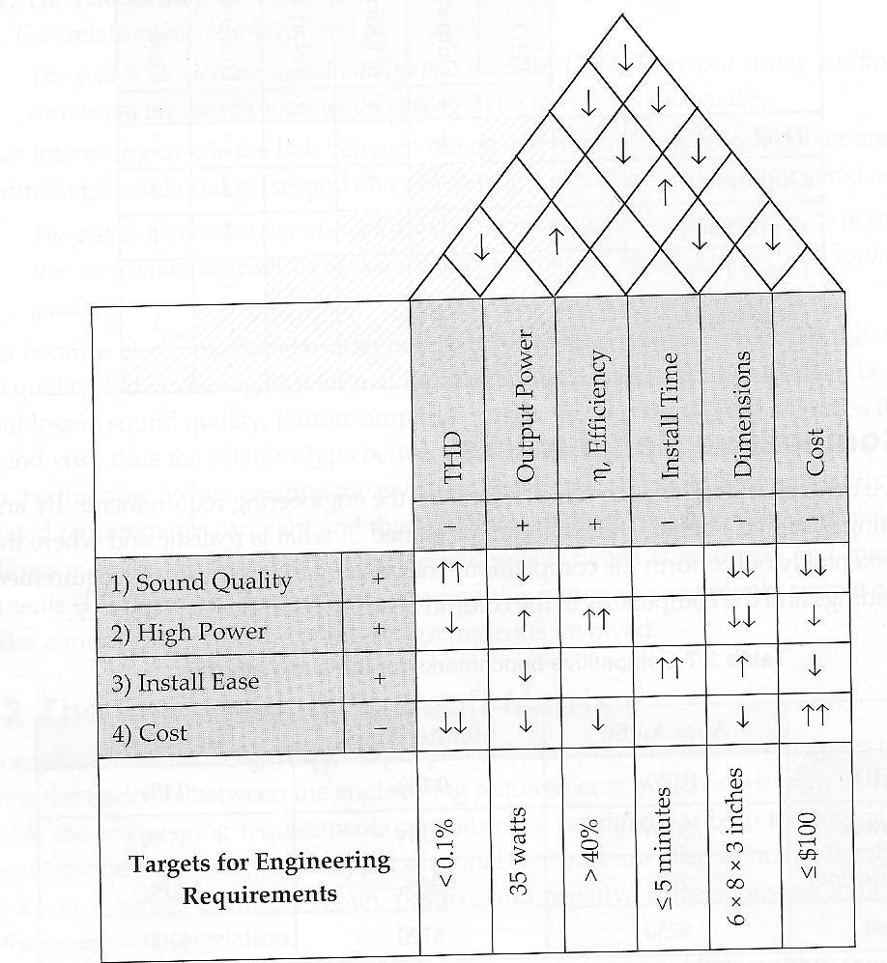
House of Quality The Complete Analysis Picture
Integrates various information
Marketing Requirements
Engineering Requirements
Engineering-marketing tradeoff matrix
Engineering tradeoff matrix
Engineering target requirements
TDH and Output Power have negative correlation
(we cannot lower distortion while keeping output power high)

Slide 42
The Requirements Specification Document
A complete requirements document will contain:
Needs, Objectives, and Background (See Chapter 2).
Requirements
Marketing requirements
Engineering requirements
Should be abstract, verifiable, and traceable
Some may be constraints
Some may be standards
Advanced Analysis
Engineering-marketing tradeoffs
Engineering-engineering tradeoffs
Benchmarks

Slide 43
Summary
Properties of Engineering Requirements
Examples of Engineering Requirements
Properties of the Requirements Specification
Advanced Requirements Analysis
Tradeoff matrices
Benchmarks

